Slide 1
Identifying important Genes in A Proteomics DATASET For Alzheimer’s Disease
Nikolaos Giagtzoglou
Python for Data Science, CSCI E-29
Harvard University
Keywords: CSCI E-29, Harvard University Extension School, Python3, Data Science, Alzheimer’s Disease

Slide 2



CSCI E-29 2018 Staff
Nenad Svrzikapa
Instructor
Lena Hajjar
Teaching Fellow
Philip Lodine
Teaching Fellow
Kaleigh Douglas
Teaching Fellow
Alan Xie
Teaching Fellow
Joe Palin
Teaching Fellow
Notes:
THIS COURSE WAS OFFERED IN SPRING OF 2018 AND THIS IS OUR TEACHING STAFF

Slide 3
Abstract
Max = [10] for a Machine Learning Project
Alzheimer’s Disease (AD) is the most common neurodegenerative diseases, affecting 1 out of 5 people over the age of 65.
The psychological and financial burden sums up to billions of US$
Treating AD has proved to be difficult, as it is a complicated disease
To device effective therapeutic strategies, we need to define the molecular signatures related to different aspects of AD, as for example age of onset, rate of progression to Dementia and the effect of genetic and environmental factors.
There have been worldwide efforts collecting -omics data (transcriptomics, proteomics, metabolomics) from different human cohorts and relating them to features of AD.
My effort focuses in analyzing one of this publicly available proteomics datasets in order to identify which proteins can reliably predict AD and Dementia.
These genes can then become the focus of drug development efforts.
The problem turned out to be a simple classification problem.

Slide 4
Required Libraries and files
Packages: synapseclient pip install synapseclient pip install --upgrade synapseclient syn = synapseclient.Synapse() syn.login('nikos73@gmail.com','#########’) files = synapseutils.syncFromSynapse(syn, 'syn5759470’)
https://www.synapse.org/#!Synapse:syn2580853/wiki/409840
Libraries: synapseutils, os, pandas, numpy, scipy, matplotlib, seaborn, sklearn

Slide 5
REFERENCES
Introduction to Machine Learning using Python Andreas C. Müller; Sarah Guido
Python Data Science Cookbook Jake VanderPlas

Slide 6
Acknowledgments
Nenad Svrzikapa
Instructors of the course
My wife Isabel

Slide 7
Supplementary Slides

Slide 8
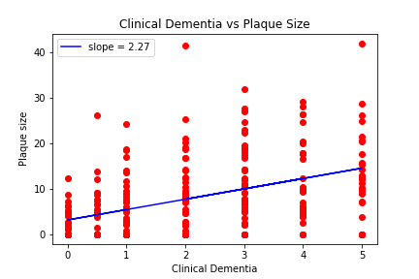
Clinical Dementia correlates positively with size of Amyloid Plaques (Fig.1)

Slide 9
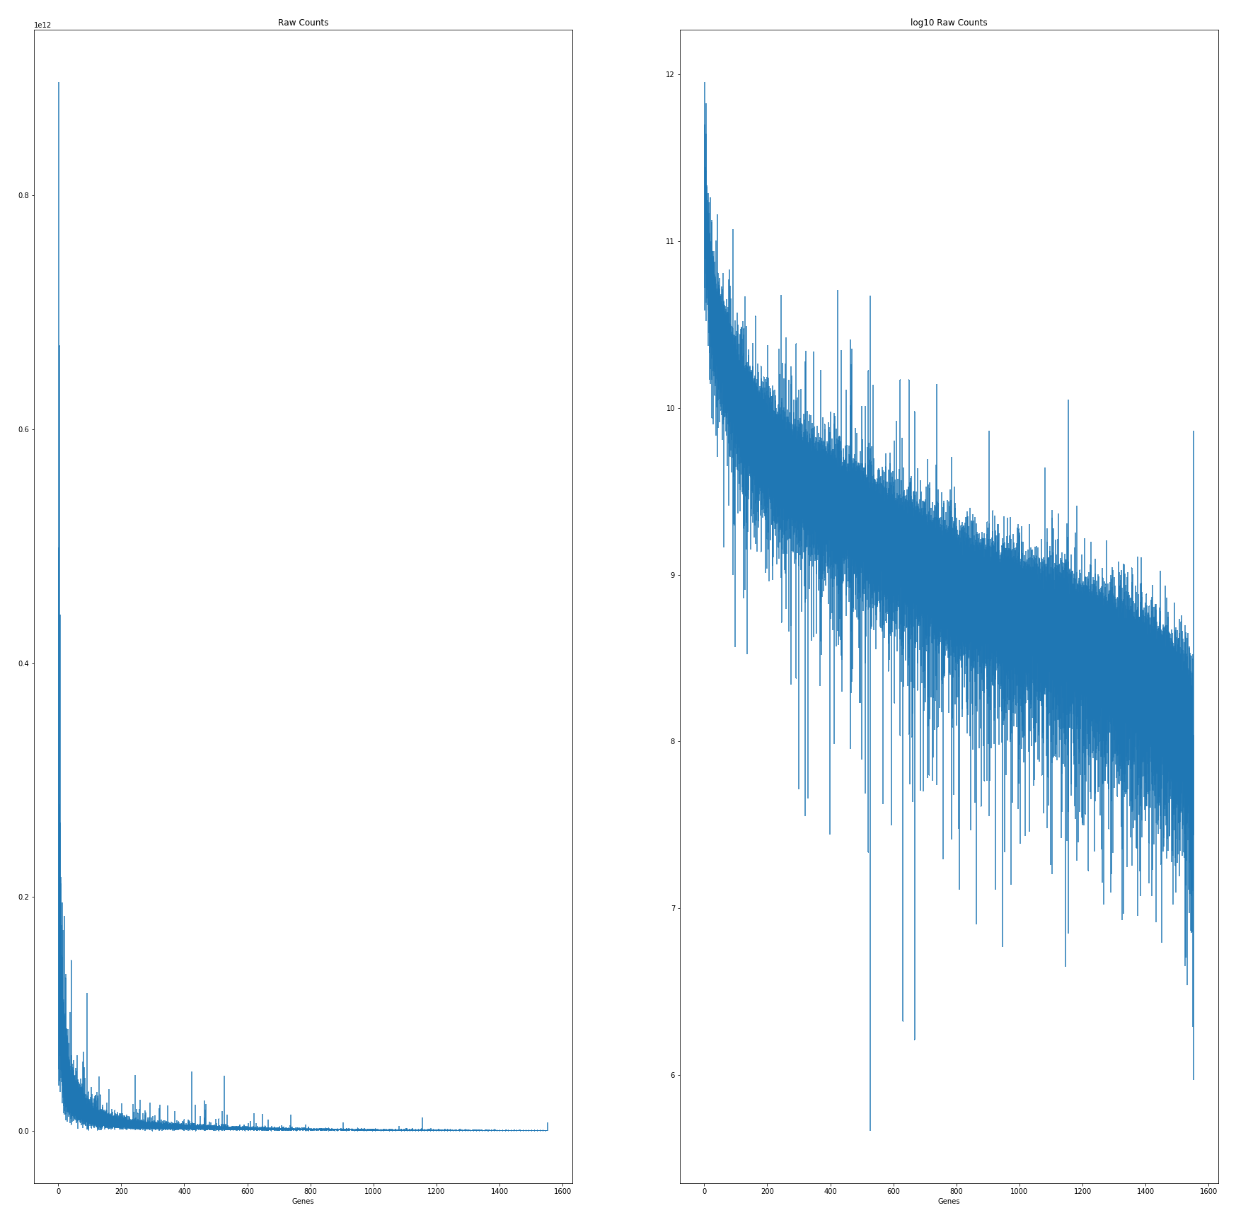
Proteins are abundant to different degrees (Fig.2)

Slide 10
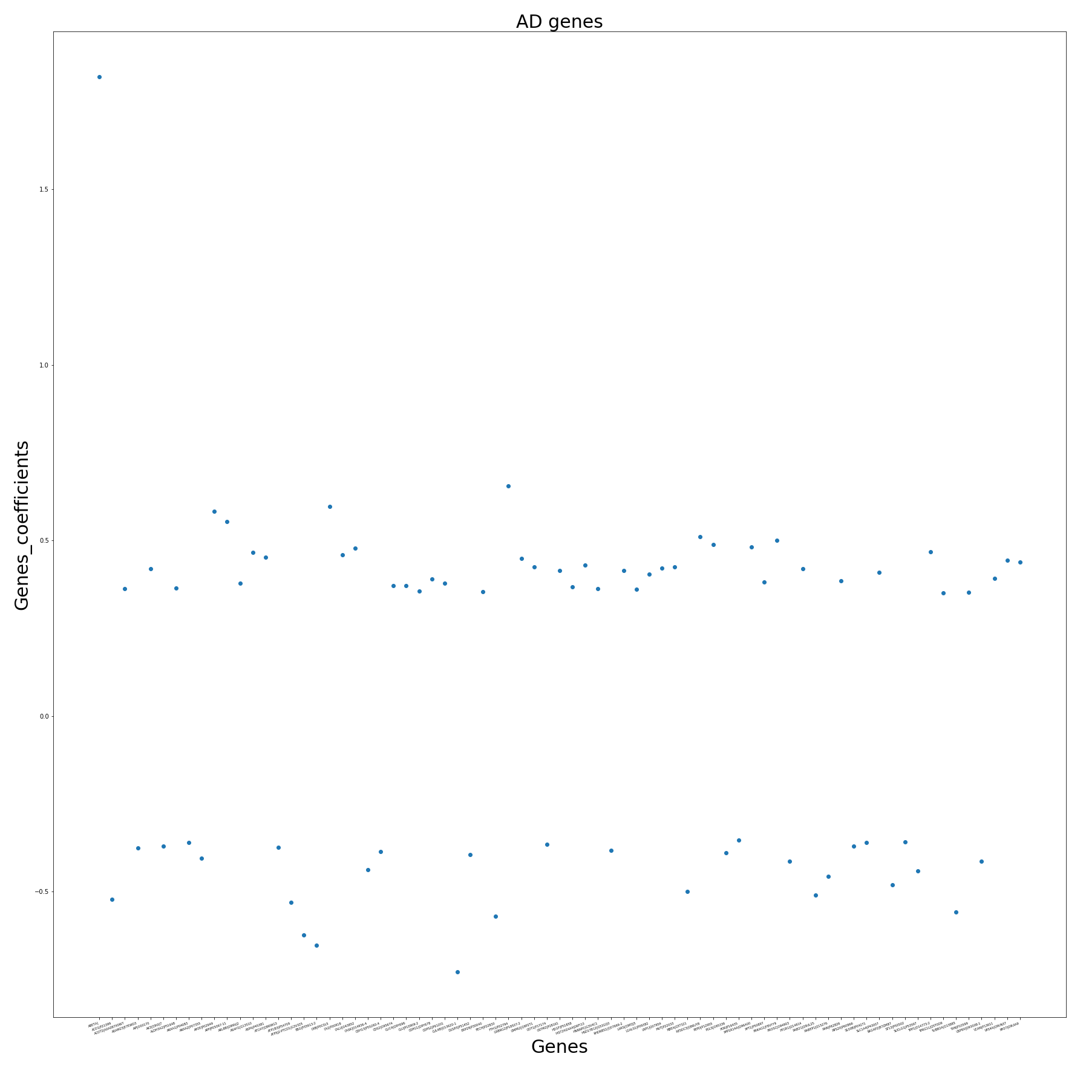
Coefficients of the most “important” genes in a linear regression (Fig.4)

Slide 11
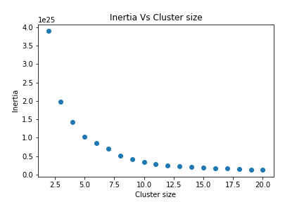
Identify coexpression clusters using KMEANS (n_clusters =10) (Fig.5)

Slide 12
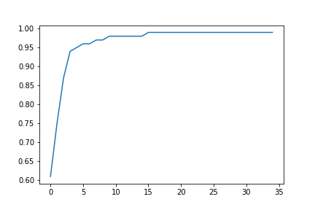
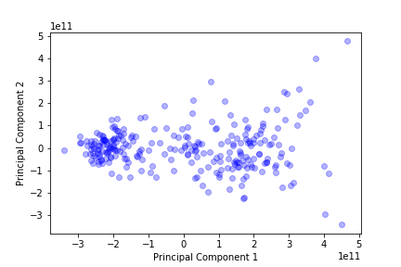
Reducing the Protein Features by Principal Component analysis down to 2 dimensions (Fig.6, Fig.6b)
Cumulative variation vs N of Principal Components
Principal Component 1 vs Principal Component 2

Slide 13
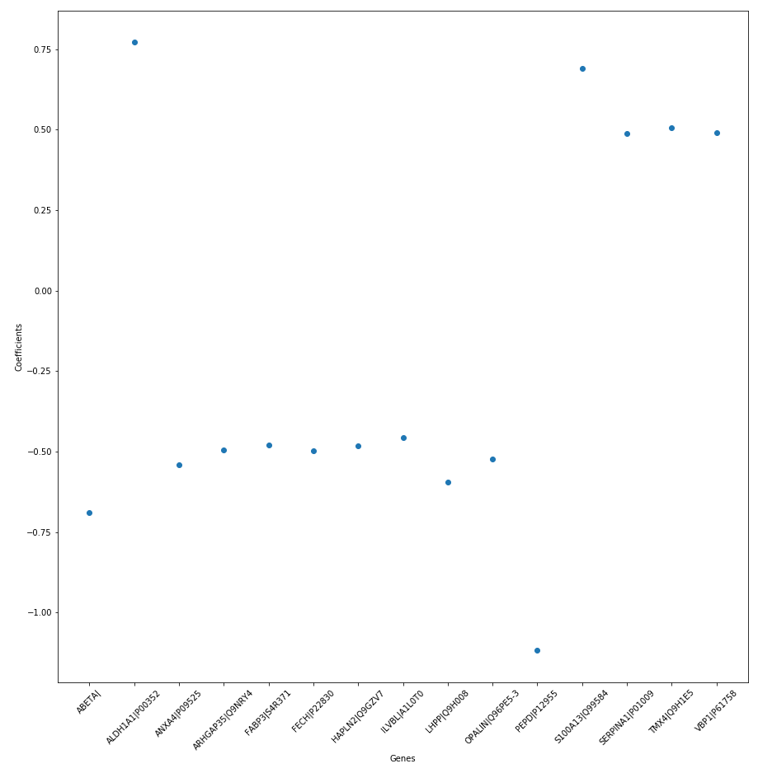
Coefficients of “important” genes (logistic regression - Fig.7)

